Slide 1
SECTOR BASED trade recommendation system
Presented by-
Anushka Sancheti
Harsha Singh
Minal Firodiya
Shagun Sengupta
Tanaya Bhagwat

Slide 2
AGENDA
Section 1: • Problem Statement
• Introduction
• Project Overview
Section 2: • System working
• Databases
• Business Logic
• User Interface
Section 3: • Conclusion
• Project Demonstration
• Q & A

Slide 3
INTRODUCTION
WHAT IS “TRADING RANGE”?
A trading range is the spread between the high and low prices traded during a period of time.
When a stock breaks through or falls below its trading range after several days of trading in a range, it usually means there is momentum (positive or negative) building.

Slide 4
OVERVIEW
PROBLEM STATEMENT
TRADE RECOMEMENDATION SYSTEM BASED ON USER SELECTED SECTORS.
(FROM NIFTY STOCKS)

Slide 5
TECHNOLOGIES USED
• Programming Language: Java , HTML, CSS, AngularJS
• IDE: Spring Tool Suite
• Database: MySql
• Web Service: Quandl API
• Server : Apache Tomcat Server

Slide 6
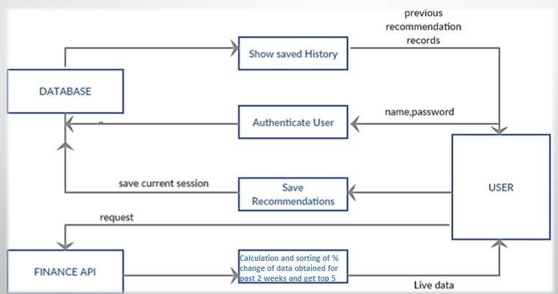
THE SYSTEM
BLOCK DIAGRAM

Slide 7
Scope of the Project
• The Sector Based Recommendation System allows the registered user to view the value of the stock prices at Nifty of the selected sector at the given instance of time.
• Once logged in, the user selects a market sector, which get filtered with the Nifty constituents that match it.
• The user is allowed to view the top recommendations, accumulated over the two weeks’ data that provide the best trading opportunities.
• The user can also save the recommendations of the current session along with the stock purchase details

Slide 8

Business Logic
Trade recommendation system takes live market data for specific sector based companies from Quandl API.
Data is taken for the period of 2 weeks.
The fetched data is run under the expression
$\frac{Last \left(today\right)−Open (2 weeks ago)}{Open (2 weeks ago)}×100$
to get the percentage of gain over the time duration.
The data is hence sorted in descending order to get the top five performing stocks.
This processed data is then displayed in the user interface where the user can wish to save the data for that day, which is stored in the database.

Slide 9
Middleware
• Created on Spring Tool Suite(STS) using object oriented Java Programming language
    • Use of DAO and Annotations in STS.
• Design Patterns/Techniques used:
    1. Model-View-Controller Pattern
    2. RESTful web services

Slide 10
Model-View-Controller Pattern:
• Features:
    • Dependency Injection.
    • Flexible and well-defined interfaces within each logic.
    • Easy handling of web development style along with separate Presentation, Intermediate and Business logic.
    • Effective interaction with User and other subsystem

Slide 11
RESTful Web Service
Features:
  • Any interface between systems using HTTP to obtain data and generate operations on those data in all possible formats
  • The most logical, efficient and widespread standard in the creation of APIs for Internet services.
  • The four very important data transactions in any REST system and HTTP specification: POST (create),GET(read and consult),PUT (edit) and DELETE.

Slide 12
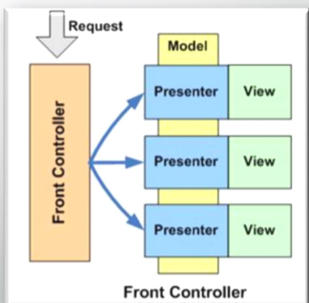
Concept of Front-Controllers
• Definition:
  • The front controller design pattern is used to provide a centralized request handling mechanism so that all requests will be handled by a single handler.
  • The front controller design pattern means that all requests that come for a resource in an application will be handled by a single handler and then dispatched to the appropriate handler for that type of request

Slide 13
USER INTERFACE
Use of HTML + CSS + AngularJS Features of AngularJS:
  • AngularJS is a structural framework for dynamic web apps.
  • It lets you use HTML as your template language and lets you extend HTML's syntax to express your application's components clearly .
  • Angular's data binding and dependency injection eliminate much of the code you currently have to write.
  • And it all happens within the browser, making it an ideal partner with any server technology.
  • Use of Directives

Slide 14

PROJECT DEMONSTRATION

Slide 15
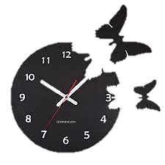
TIME FOR QUESTION

Slide 16

THANK YOU

